Slide 1
Jermyn Borough Council Meeting
7/2/20

Slide 2
Meeting Agenda
Call to Order
Pledge of Allegiance
Roll Call
Previous Meeting Minutes
Treasurer’s Report/Bills Payable
Correspondence
Public Comment
Professional Reports
Committee Reports
Borough Manager Report
Fireworks Ordinance
Feral Cats
Crystal Fire Company
New Business
Adjournment

Slide 3
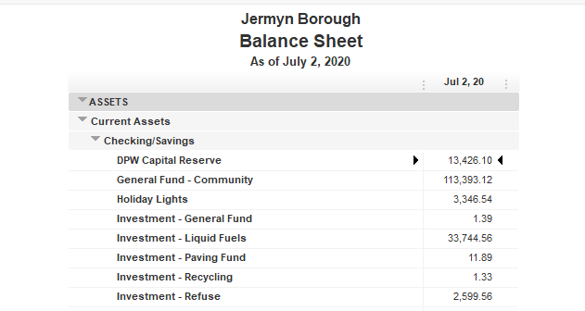
Treasurer’s report

Slide 4
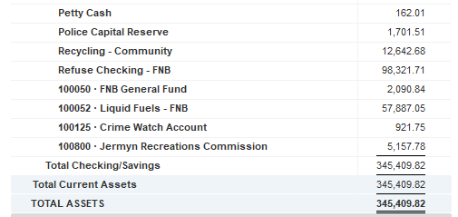
Treasurer’s report

Slide 5
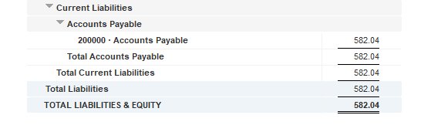
Treasurer’s report

Slide 6


